Slide 1
EVOLUTION OF ENTERPRISE SYSTEM ARCHITECTURE
IMAN FATIMA (2021-SE-10)
KAUSAR FATIMA (2021-SE-25)
UME HABEEBA (2021-SE-27)
LAIBA AMBER EJAZ (2021-SE-37)
KHADEEJA RASTI (2021SE-53)

Slide 2
Software Architecture
A software architecture refers to the organizational structure that governs the software elements and resources within a software system.
Software elements and resources are represented as subsystems.
Each of these subsystems has specific responsibilities and relationships with other subsystems within the software system.

Slide 3
Traditional Application Development
Early Application Development: In the beginning, applications were built from scratch, making development costly and inefficient.
Operating Systems: Operating systems were introduced to separate hardware concerns from applications, improving efficiency and easing portability.
Data Management: Initially, applications were responsible for data storage and retrieval, leading to tight coupling and data consistency issues.

Slide 4
Traditional Application Development
Database Management Systems: Database management systems (DBMS) provided physical and logical data independence, allowing for more efficient data management.
Graphical User Interfaces (GUIs): GUIs were developed to enhance user interactions with complex information systems, catering to the needs of knowledge workers. Modern GUIs are built using advanced frameworks, simplifying development and improving usability.

Slide 5
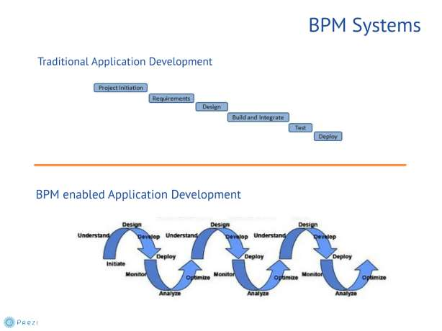

Slide 6
Enterprise Applications and their Integration
The evolution of information systems enabled the development of increasingly sophisticated information systems.
Enterprise applications within information systems are crucial for managing core assets such as customers, personnel, products, and resources.
As enterprises developed more application systems for various became significant challenges.

Slide 7
Enterprise Resource Planning Systems
Enterprise Resource Planning (ERP) systems offer integrated databases that span across different areas of an organization, providing a centralized data repository accessible through client software.

Slide 8
New market demands and increased customer needs which include:
Supply Chain Management (SCM)
Customer Relationship Management (CRM) systems

Slide 9
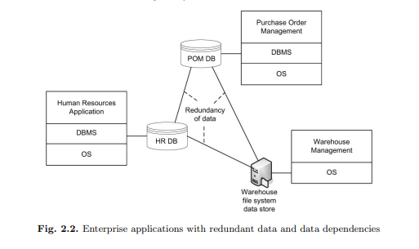
Enterprise applications with redundant data and data dependencies

Slide 10
Enterprise Application Integration
Data integration issues arise when the same data is stored differently in various systems, with differences in data structures, attribute names, and even semantics.

Slide 11
Point-to-Point Integration
Point-to-point integration approach refers to a method of connecting individual software applications or systems directly to one another to enable data exchange and communication.

Slide 12
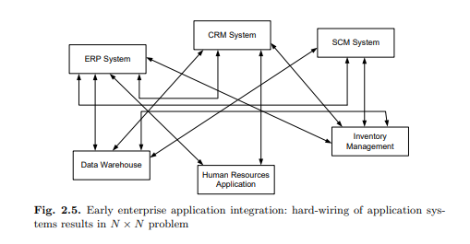
N x N problem
In the context provided, the "N x N problem" refers to the challenge that arises when integrating multiple software applications using a point-to-point integration approach.

Slide 13
Hub-and-Spoke Integration
Hub-and-Spoke Integration is an architectural approach used in enterprise application integration (EAI) to connect and streamline the interaction between multiple software applications or systems within an organization. In this model:
Centralized Hub: The "hub" is a centralized component (middleware) that acts as a focal point for communication and data exchange. It serves as an intermediary for all connected applications.
Spokes: The "spokes" represent the various software applications or systems that need to communicate with each other. These applications are connected to the central hub.

Slide 14
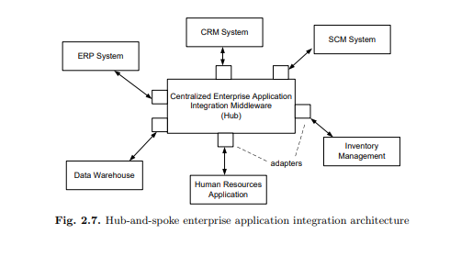
Hub-and-spoke enterprise application integration architecture

Slide 15
Enterprise Modelling and Process Orientation
Enterprise Modelling:
Structured representation of an organization.
Aids in understanding, analysis, and optimization.
Valuable for strategic planning and decision-making.
Enables process optimization and adaptation to change.
Process Orientation:
Emphasis on interconnected processes.
Aims for efficiency, effectiveness, and quality.
Reduces costs and enhances agility.
Promotes a customer-centric approach.
Often related to Business Process Management (BPM)..

Slide 16
Importance in Business Administration:
Indispensable in Modern Business
Adaptability and Efficiency
Core Driver of Success
Major Factors:
Increasing Complexity
Advancements in Technology
Workflow and Business Process Management

Slide 17
Value Chains:
Definition:
Value chains are a fundamental concept in business administration. They represent the various activities and functions that a company performs to achieve its business goals.
Value chains encompass both internal and external processes that contribute to the creation of value and the delivery of products or services.
Importance:
Value chains are of paramount importance for understanding a company's operations:
They offer a structured approach to break down and analyze the activities a company performs.
By examining value chains, businesses can assess how each component contributes to their overall success.
Understanding the value chain helps in identifying opportunities for improvement, cost reduction, and enhanced efficiency.
It offers a comprehensive view of the relationships between different parts of the organization and how they connect with external partners.

Slide 18
Value System:
A value system is a broader concept that encompasses the value chains of cooperating enterprises.
It includes various partners and stakeholders in the overall delivery of value to the end customer.
Components of a Value System:
The value system includes suppliers, manufacturers, distributors, retailers, and customers.
These components work in coordination to create and deliver products or services to the end consumer.

Slide 19
Functional Decomposition
Definition:
Functional decomposition is a method used to break down complex business functions or processes into smaller, more manageable components.
It involves dividing a high-level function into finer-grained sub-functions, creating a hierarchical structure of functions within an organization.
Importance:
Functional decomposition holds great significance in business processes:
It simplifies the analysis and understanding of complex operations within an organization.
Breaking down functions into smaller units helps identify specific areas that may require improvement or optimization.
It enables a structured approach to enhancing efficiency within individual processes and across the entire organization.

Slide 20
Functional Decomposition and Business Functions
Significance of Breaking Down Business Functions:
It aids in understanding the intricacies of business operations by dissecting them into smaller parts.
Allows for a detailed analysis of each business function, leading to optimization.
Helps in identifying areas of improvement and potential efficiencies.
Primary and Secondary Business Functions:
Primary business functions include core activities like inbound logistics, operations, outbound logistics, marketing, and sales.
Secondary business functions, such as human resources, technology development, procurement, and infrastructure, support the primary functions.

Slide 21
Organizational Business Processes
Definition:
Organizational business processes are the structured activities and workflows that define how a company conducts its core operations.
These processes encompass the fundamental tasks that drive the organization's mission and strategic goals.
Importance:
Organizational business processes are at the heart of an enterprise's functionality:
They represent the day-to-day activities and functions that directly impact an organization's success.
Effective management of these processes is essential for achieving business objectives and ensuring efficiency.
Optimizing organizational business processes can lead to cost savings, improved customer satisfaction, and competitive advantage.

Slide 22
Business-to-Business Processes
Definition:
Business-to-Business (B2B) processes refer to the interactions and collaborations between processes of different companies or organizations.
These processes are crucial for the seamless flow of goods, services, and information across the business ecosystem.
Importance:
Business-to-Business processes are essential components within a value system:
They facilitate cooperation and coordination among various companies involved in a value chain.
Efficient B2B processes lead to improved supply chain management, faster order processing, and enhanced overall business performance.
They contribute to the success of the value system by ensuring that products and services move smoothly from suppliers to end-users.

Slide 23
Workflow Management
In the 1990s, the Workflow Management Coalition (WfMC) was founded to bundle workflow related activities by vendors, users, and academia.
Workflow is the automation of a business process, in whole or in part, during which documents, information, or tasks are passed from oneparticipant to another for action, according to a set of procedural rules.
A workflow management system is a software system that defines, creates, and manages the execution of workflows through the use of software, running on one or more workflow engines,interact with workflow participants, and, where required, invoke the use of IT tools and applications.

Slide 24
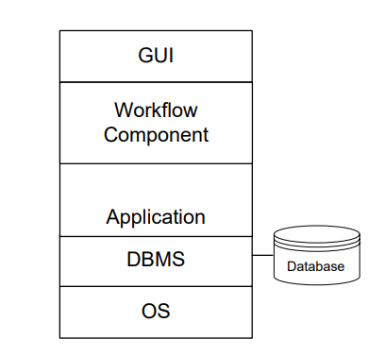
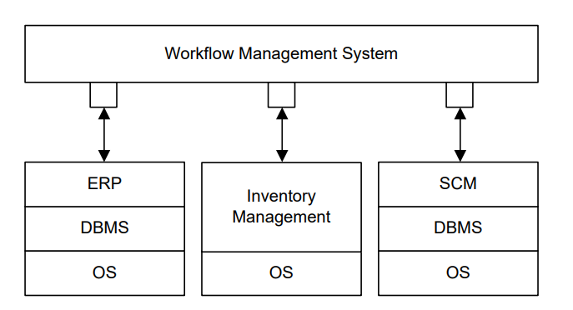
Workflows and Applications
Single-application workflow systems achitecture
Multiple-application workflow systems architecture

Slide 25
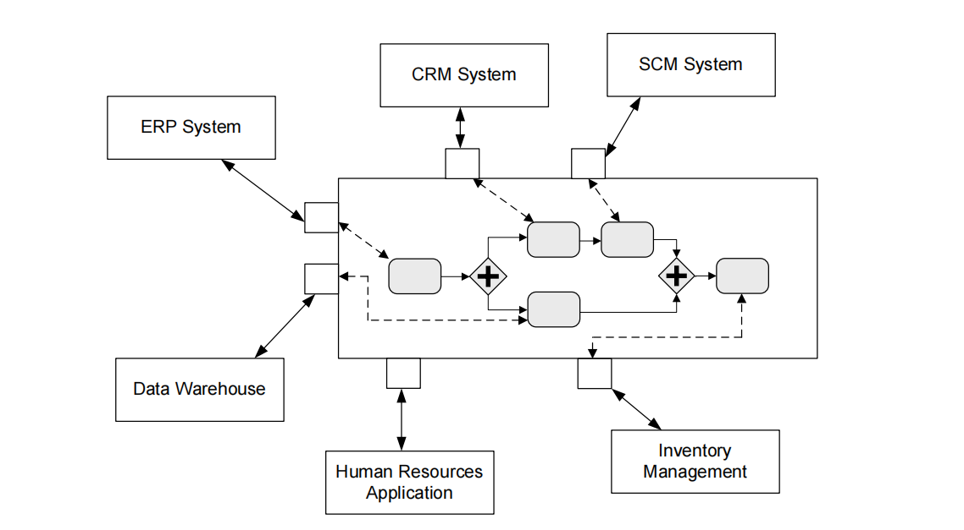
System Workflows
A system workflow consists of activities that are implemented by software systems without any user involvement.

Slide 26
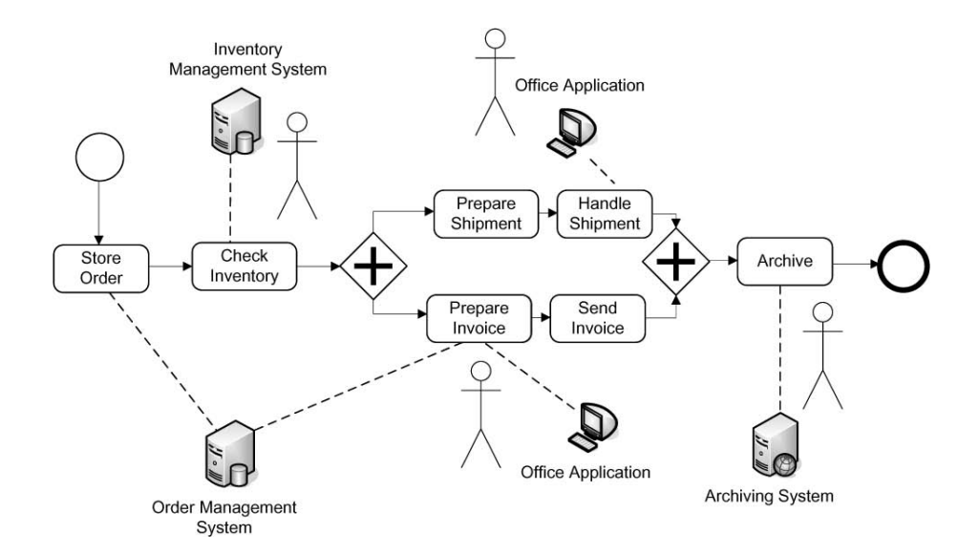
Human Interaction Workflows
Workflows in which humans are actively involved and interact with information systems are called human interaction workflows.

Slide 27
Challenges for Workflow Management
Limitations for Knowledge Workers
Technical Integration Challenges
Granularity Mismatch
Database Administration
Process Support Without Workflow Systems

Slide 28
Service-Oriented Architecture in Enterprise Computing
Steve Burbeck's definition of service orientation: "Services are loosely coupled computing tasks communicating over the internet that play a growing part in business-to-business interactions."
Emphasize dynamic, automated discovery and use of services in service-oriented architecture.

Slide 29
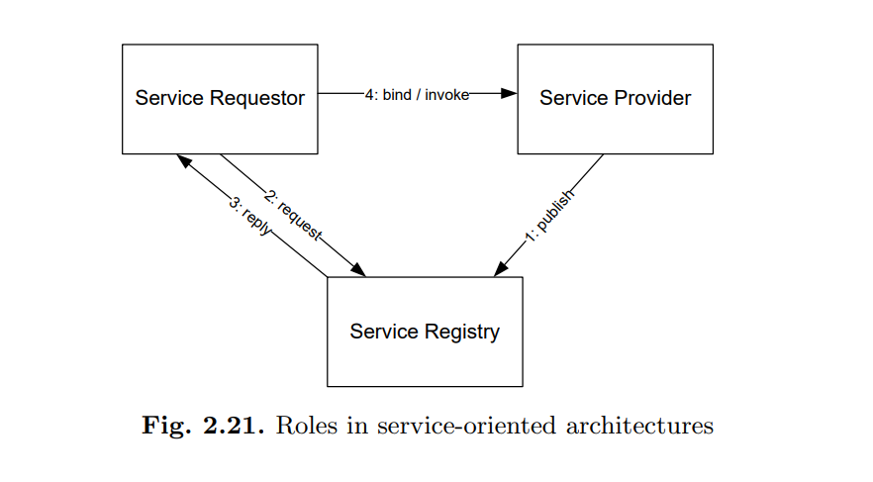
Service-Oriented Architectures

Slide 30
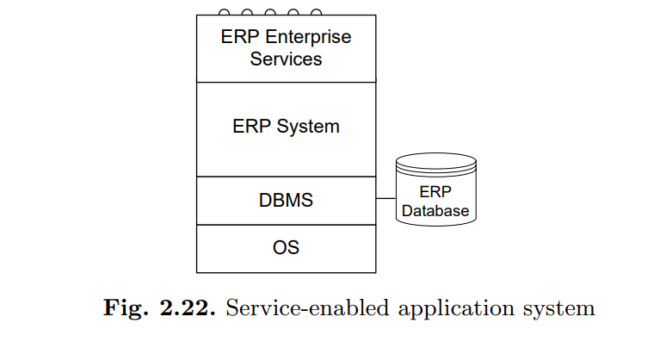
Enterprise Services
Functionality in enterprise computing provided by services.
Visualize a service-enabled application system with functionality provided through services.

Slide 31
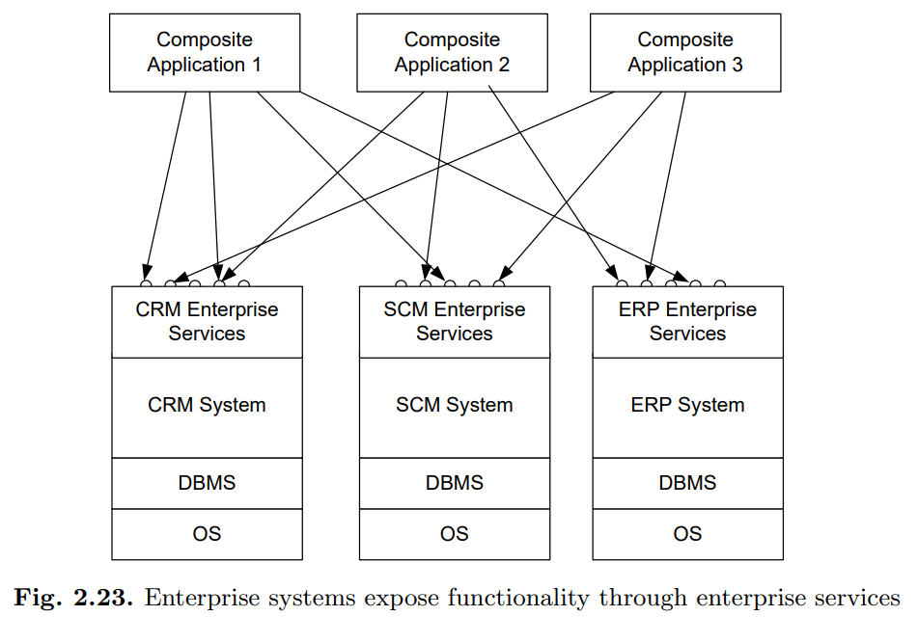
Composite Service-Based Applications
Concept of composite applications built on existing systems via enterprise services.
Role of business processes and process orchestration in composite applications.

Slide 32
Enterprise Services and Service-Oriented Architectures
Enterprise Services are often finely granulated, tailored to specific applications. | SOA emphasizes coarser-grained, reusable services independent of specific applications.
Enterprise Services typically use local registries with manual discovery. | SOA employs global registries and automated discovery for services.
Enterprise Services involve tight integration with specific applications. | SOA promotes loose coupling, allowing services to be used more flexibly across applications.

Slide 33
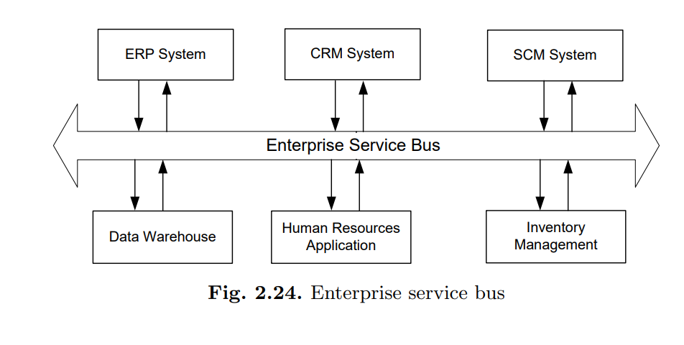
Enterprise Services Bus
An Enterprise Services Bus (ESB) is like a central communication hub for different software systems in a company, helping them talk to each other and share information efficiently, like a traffic controller for data. It simplifies and manages data exchange between various applications.

Slide 34
Service Composition
Service composition is the process of combining various software services to create a composite application. This involves defining a sequence of activities that make up a business process, often represented in a process model
Service composition is like putting together different building blocks to make something new. Imagine you have pieces of a puzzle, and when you connect them in the right order, you create a bigger picture.

Slide 35
Conclusion
Adaptive Evolution
Integration Matters
Process Orientation
Workflow Management
Service-Oriented Approach
Competitive Advantage

